Slide 1
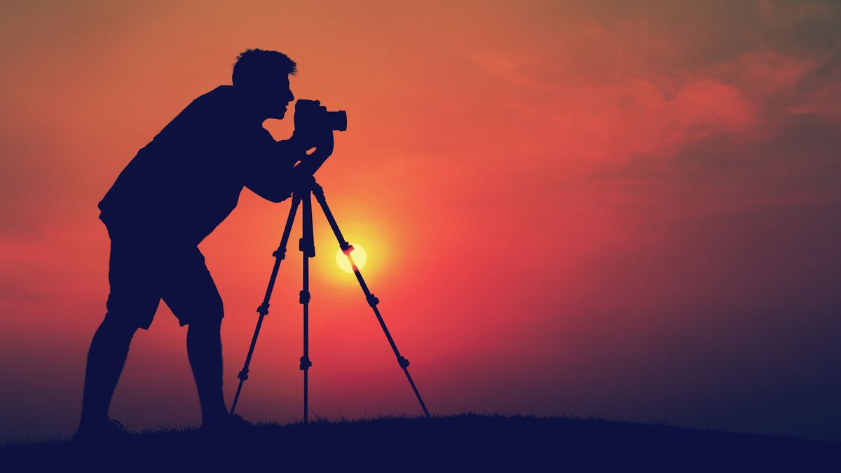
GANGADHARPUR MAHAVIDYAMANDIR
HOWRAH
PHOTOGRAPHY CLUB
Make a statement without saying a word……………

Slide 2
Photography Club of Gangadharpur Mahavidyamandir is a platform to bring together the like-minded people and share knowledge about the art and science of Photography. The club encourages students to study light and imparts tips on composition. The club organizes activities that give a chance to learn photography, utilize their camera to the fullest and become sensitized to the world around. The club focuses on interaction between experts and students in addition to enhancing peer learning in photography and builds an environment to capture memories forever.

Slide 3
History of photography
Photography as a medium is less than 200 years old. But in that brief span of history, it has evolved from a crude process using caustic chemicals and cumbersome cameras to a simple yet sophisticated means of creating and sharing images instantly. Discover how photography has changed over time and what cameras look like today.
The first "cameras" were used not to create images but to study optics. The Arab scholar Ibn-Al-Hythan(945–1040), also known as Alhazen, is generally credited as being the first person to study how we see. He invented the camera obscura, the precursor to the pinhole camera, to demonstrate how light can be used to project an image onto a flat surface. Earlier references to the camera obscura have been found in Chinese texts dating to about 400 B.C. and in the writings of Aristotle around 330 B.C.
On a summer day in 1827, French scientist Joseph Nicephore Niepce developed the first photographic image with a camera obscura. Niepce placed an engraving onto a metal plate coated in bitumen and then exposed it to light. The shadowy areas of the engraving blocked light, but the whiter areas permitted light to react with the chemicals on the plate.

Slide 4
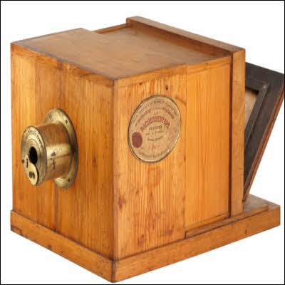
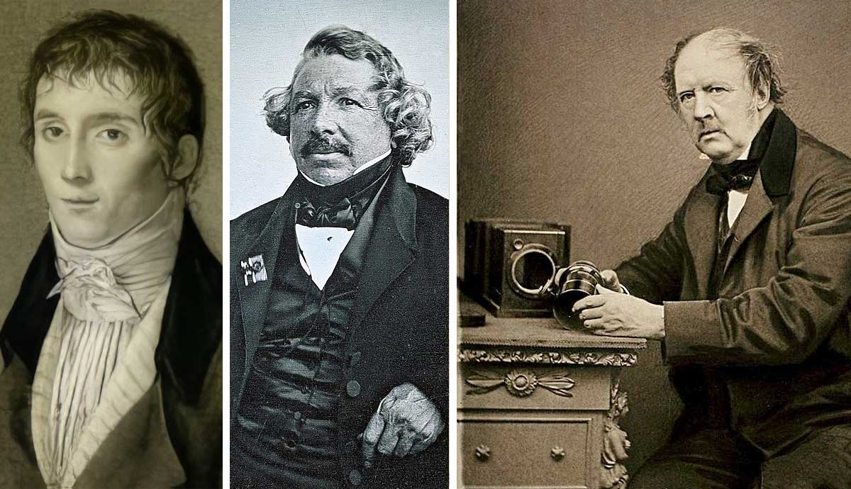
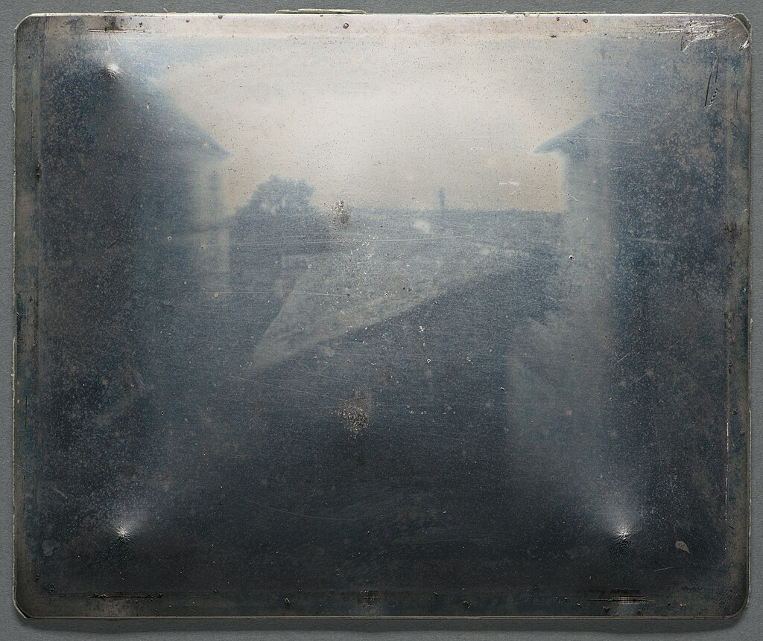
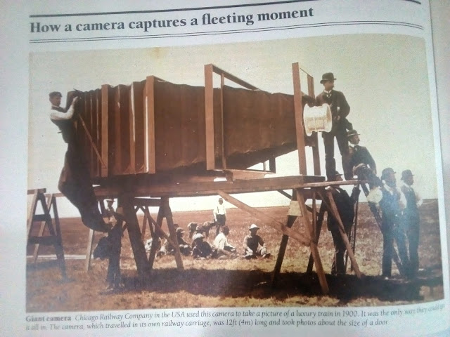
First Camera ,Photo graphist and Photography in the world
World First Camera
Left to right: Joseph Nicéphore Niépce, Louis Daguerre, Henry Fox Talbot
The earliest surviving photograph(1826)
by Joseph Nicéphore Niépce
The Giant camera(World biggest camera)

Slide 5
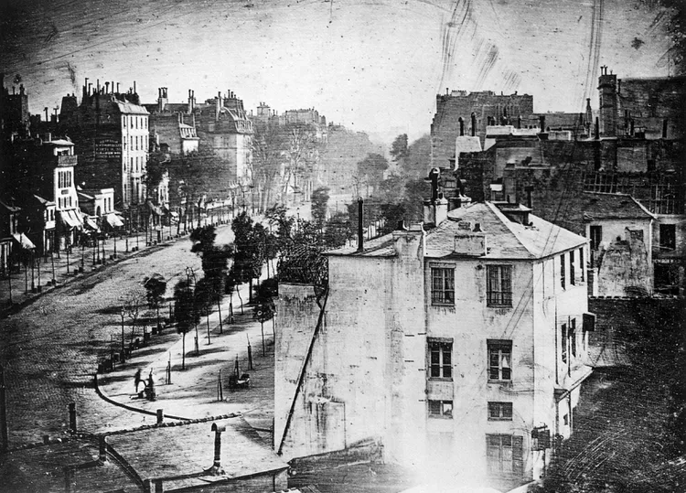
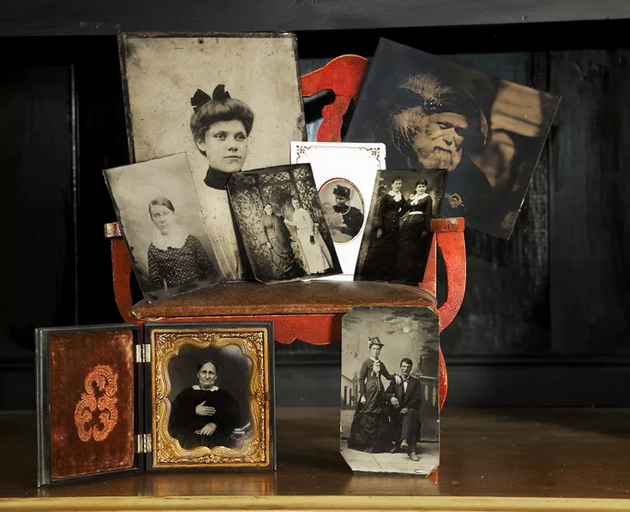
Evolution of Photography
Negative to Positive Process
The drawback to daguerreotypes is that they cannot be reproduced; each one is a unique image. The ability to create multiple prints came about thanks to the work of Henry Fox Talbot, an English botanist, mathematician and a contemporary of Daguerre. Talbot sensitized paper to light using a silver-salt solution. He then exposed the paper to light. The background became black, and the subject was rendered in gradations of gray. This was a negative image. From the paper negative, Talbot made contact prints, reversing the light and shadows to create a detailed picture. In 1841, he perfected this paper-negative process and called it a calotype, Greek for "beautiful picture.
Boulevard du Temple, Paris, is a daguerreotype taken by Louis Daguerre circa 1838/39
Tintype collection of old family photographs.

Slide 6
Flexible Roll Film
In 1889, photographer and industrialist George Eastman invented film with a base that was flexible, unbreakable, and could be rolled. Emulsions coated on a cellulose nitrate film base, such as Eastman's, made the mass-produced box camera a reality. The earliest cameras used a variety of medium-format film standards, including 120, 135, 127, and 220. All of these formats were about 6 cm wide and produced images that ranged from rectangular to square.
The 35 mm film most people know today was invented by Kodak in 1913 for the early motion picture industry. In the mid-1920s, the German camera maker Leica used this technology to create the first still camera that used the 35 mm format. Other film formats also were refined during this period, including medium-format roll film with a paper backing that made it easy to handle in daylight. Sheet film in 4-by-5-inch and 8-by-10-inch sizes also became common, particularly for commercial photography, ending the need for fragile glass plates.
In the early 1940s, commercially viable color films were brought to the market by Kodak, Agfa, and other film companies. These films used the modern technology of dye-coupled colors in which a chemical process connects the three dye layers together to create an apparent color image.

Slide 7
Photographic Prints
Traditionally, linen rag papers were used as the base for making photographic prints. Prints on this fiber-based paper coated with a gelatin emulsion are quite stable when properly processed. Their stability is enhanced if the print is toned with either sepia (brown tone) or selenium (light, silvery tone).

Slide 8
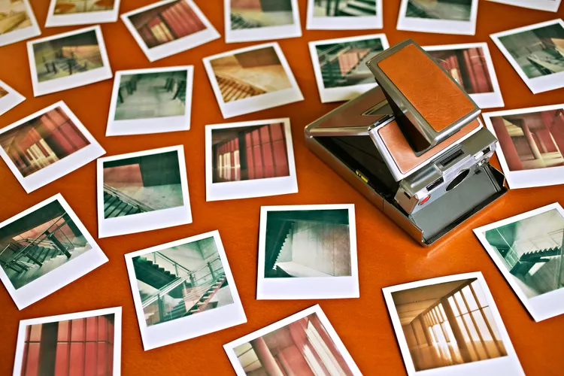
Instant Photography
Instant photography was invented by Edwin Herbart Land, an American inventor and physicist. Land was already known for his pioneering use of light-sensitive polymers in eyeglasses to invent polarized lenses. In 1948, he unveiled his first instant-film camera, the Land Camera 95. Over the next several decades, Land's Polaroid Corporation would refine black-and-white film and cameras that were fast, cheap, and remarkably sophisticated. Polaroid introduced color film in 1963 and created the iconic SX-70 folding camera in 1972.
Instant photos and camera from the 1970's.

Slide 9
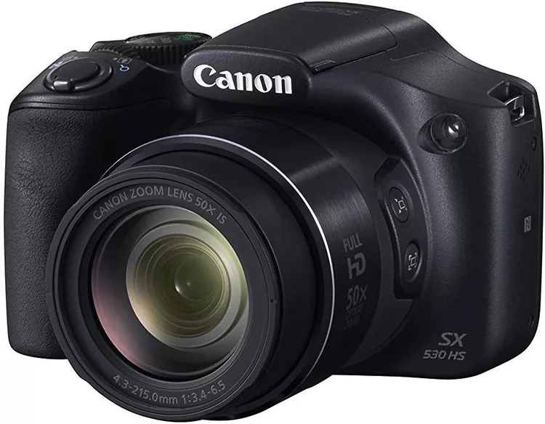
Modern Cameras
Over the next several decades, major manufacturers such as Kodak in the U.S., Leica in Germany, and Canon and Nikon in Japan would all introduce or develop the major camera formats still in use today. Leica invented the first still camera to use 35 mm film in 1925, while another German company, Zeiss-Ikon, introduced the first single-lens reflex camera in 1949. Nikon and Canon would make the interchangeable lens popular and the built-in light meter commonplace.

Slide 10

Digital and Smartphone Cameras
The roots of digital photography, which would revolutionize the industry, began with the development of the first charged-coupled device at Bell labs in 1969. The CCD converts light to an electronic signal and remains the heart of digital devices today. In 1975, engineers at Kodak developed the very first camera creating a digital image. It used a cassette recorder to store data and took more than 20 seconds to capture a photo.
By the mid-1980s, several companies were at work on digital cameras. One of the first to show a viable prototype was Canon, which demonstrated a digital camera in 1984, although it was never manufactured and sold commercially. The first digital camera sold in the U.S., the Dycam Model 1, appeared in 1990 and sold for $600. The first digital SLR, a Nikon F3 body attached to a separate storage unit made by Kodak, appeared the following year. By 2004, digital cameras were outselling film cameras.

Slide 11
Activity module of the photography club
In the table below, we have endeavored to provide a glimpse of the photography curriculum:
Part one:
The World of Smartphone Photography
Lenses and Accessories
Composition
Motion & Depth
Landscape Photography
Portrait Photography
Lowlight and Nighttime
Apps and Editing basics
Part two:
Nature and Wildlife
City and travel
Event photography
Documentary
Still life photography
Photoshop Apps

Slide 12

Register now:
ph.no.-8100453097
mail id:
creativephotogm@gmail.com
GOOGLE FORM:
https://docs.google.com/forms/d/e/1FAIpQLSd1zaAb0yVnq-d8EZX7XhG5hfw-fsCl41P2tn4nO15BEyi8ow/viewform?usp=header

